Slide 1
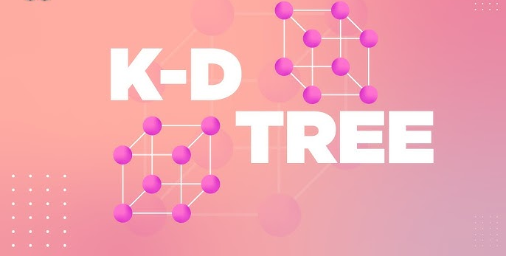

KD-Tree (K-Dimensional Tree) - Advanced Data Structure

Slide 2
Introduction of KD-Tree
KD-Tree is an advanced data structure that efficiently organizes multi-dimensional data. It is particularly useful in AI applications such as nearest neighbor searches, clustering, and range queries, where quick access to data points in high-dimensional spaces is vital.

Slide 3





Features KD-Tree
KD-Tree, or K-Dimensional Tree, is a binary tree used to partition space into regions for efficient
querying.
Definition and Structure
Applications
Comparison to Other Structures
Used in graphics, machine learning, and robotics.
KD-Tree is a binary tree used for space partition.
KD-Trees are simpler but less efficient in high dimensions.

Slide 4
How KD-Tree Works
The KD-Tree is constructed by recursively selecting a dimension (axis) to split the points. Initially, one selects the median point of the chosen dimension, which becomes a node, and the remaining points are subdivided into left and right groups.
1. Building the Tree
3. Searching for Points
The KD-Tree is constructed by recursively selecting a dimension to split the points, using median points and optimizing search.
Searching involves navigating the tree based on criteria, using backtracking to optimize nearest neighbor searches.
2. Insertion of Points
Inserting a new point involves traversing from the root to determine its position, maintaining tree balance for efficient querying.

Slide 5




Nearest Neighbor Search
Definition
Algorithm Process
Performance and Applications
Finding closest point(s) in multi-dimensional space.
Utilizes KD-Tree for efficient searching.
Improves query performance, critical for large datasets.

Slide 6
KD-Tree Variants and Optimizations
Balanced KD-Trees
Enhances search efficiency by ensuring even distribution of points.
Dynamic KD-Trees
Supports efficient point insertion and removal in changing datasets.
Approximate Nearest Neighbor Search
Speeds up retrieval by returning 'close enough' points.

Slide 7



Limitations of KD-Tree
1
Curse of Dimensionality
Performance degrades in high dimensions.
2
Inefficiency with Many Data Points
Unbalanced trees increase search time.
3
Maintenance Overhead
Frequent updates lead to computational costs.

Slide 8



Real-World Applications
Geospatial Analysis
Computer Vision
Machine Learning
KD-Trees enhance various ML algorithms, supporting fast lookups and improving computational efficiency in clustering and classification.
KD-Trees are widely used in GIS for efficiently searching spatial data, enabling rapid querying of geographic points.
In computer vision, KD-Trees assist in fast nearest neighbor searches for image features, crucial for object recognition tasks.

Slide 9

Comparison with Other Structures
The choice between KD-Tree and R-Tree often depends on the nature of the data and the specific queries being performed.
1
Comparison with R-Tree
KD-Trees work well in fixed-dimensional spaces, while R-Trees excel in handling spatial data with varying region sizes, making them better for bounding box queries.
2
Comparison with Ball Tree
Ball Trees organize data points into nested hyperspheres, offering efficient searches in higher dimensions and handling various distance metrics.
3
Choosing the Right Structure
The choice among KD-Trees, R-Trees, and other structures depends on application nature, data dimensionality, and specific performance requirements.

Slide 10



Future of KD-Tree in AI
Integration with Deep Learning
Hybrid Approaches
KD-Trees may enhance efficiency in training and inference tasks.
Future structures may integrate KD-Trees with LSH to tackle high-dimensional challenges.

Slide 11
SAMPLE PYTHON CODE
# KD-Tree Node
class KDNode:
def __init__(self, point, axis, left=None, right=None):
self.point = point # The (x, y) point
self.axis = axis # Splitting axis: 0 = x, 1 = y
self.left = left # Left subtree
self.right = right # Right subtree
# Function to build the KD-Tree
def build_kdtree(points, depth=0):
if not points:
return None
k = 2 # number of dimensions
axis = depth % k
# Sort points and choose median as root
points.sort(key=lambda point: point[axis])
median = len(points) // 2
return KDNode(
point=points[median],
axis=axis,
left=build_kdtree(points[:median], depth + 1),
right=build_kdtree(points[median + 1:], depth + 1)
)
)

Slide 12
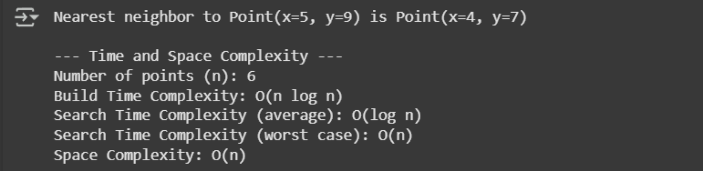
OUTPUT OF CODE and GITHUB LINK
https://github.com/JananiV002/ADS-KD-Tree-CIA2.git - GITHUB LINK

Slide 13
THANK YOU
JANANI. V
24120010

